Slide 1
Chapter 7

Slide 2
Objectives

Slide 3
Objectives (cont.)

Slide 4
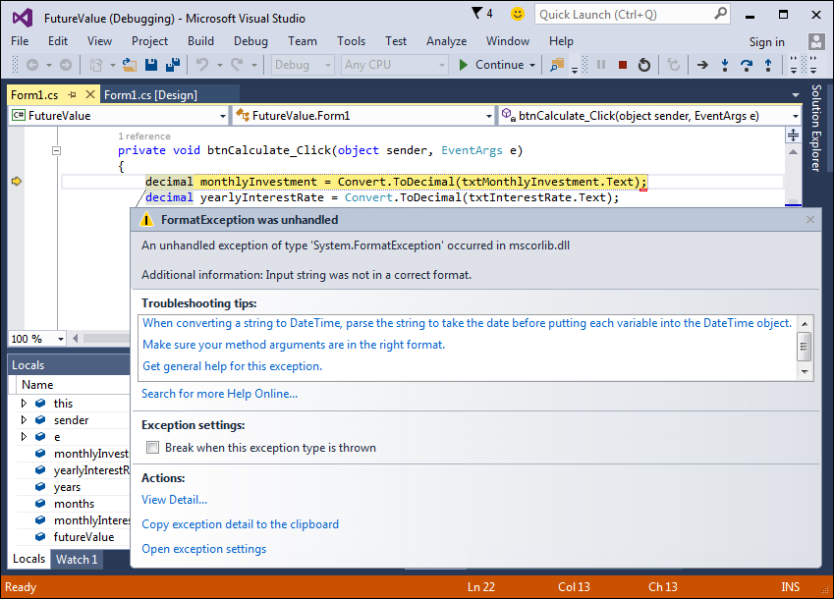
The dialog box for an unhandled exception

Slide 5
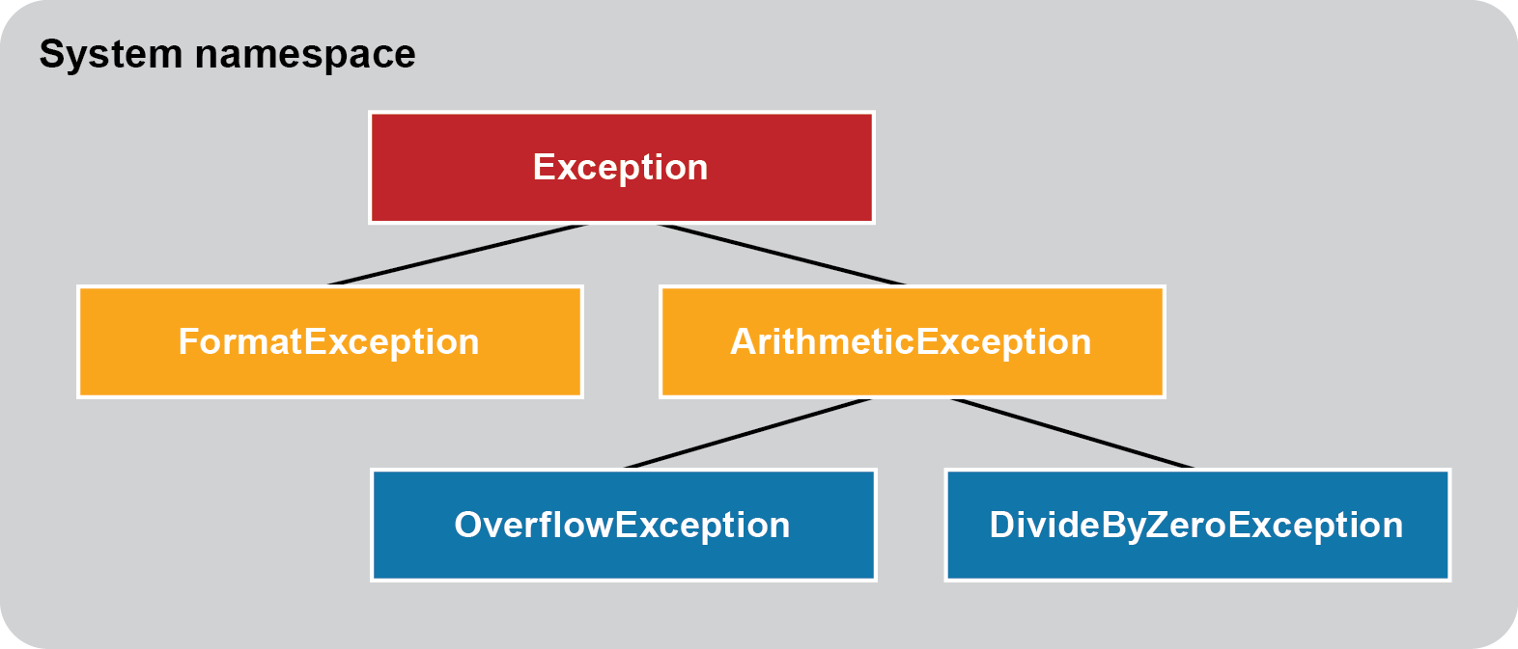
The Exception hierarchy for five common exceptions

Slide 6
Methods that might throw exceptions

Slide 7
The syntax to display a dialog box with an OK button

Slide 8
The syntax for a simple try-catch statement

Slide 9
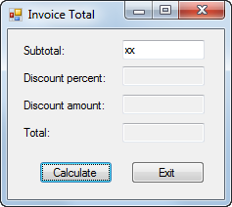
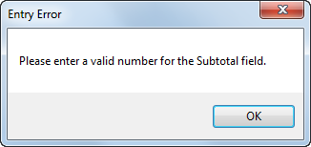
The dialog box that’s displayed for an exception

Slide 10
The syntax for a try-catch statement that accesses the exception

Slide 11
A try-catch statement that accesses an exception

Slide 12
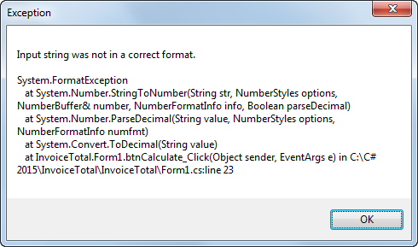
The dialog box that’s displayed for an exception

Slide 13
The syntax for a try-catch statement that catches specific types of exceptions

Slide 14
A statement that catches two specific exceptions

Slide 15
The syntax for throwing a new exception

Slide 16
A method that throws an exception when an exceptional condition occurs

Slide 17
Code that throws an exception for testing

Slide 18
Code that rethrows an exception

Slide 19
The code for the Future Value application with exception handling

Slide 20
The code for the Future Value application with exception handling (cont.)

Slide 21
The code for the Future Value application with exception handling (cont.)

Slide 22
Code that checks that an entry has been made

Slide 23
Code that checks an entry for a valid range

Slide 24
A method that checks for a required field

Slide 25
A method that checks for a valid numeric format

Slide 26
A method that checks for a valid numeric range

Slide 27
Code that checks the validity of one entry

Slide 28
Code that uses a series of simple if statements

Slide 29
Compound conditions in a single return statement

Slide 30
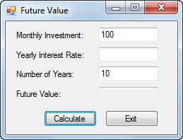
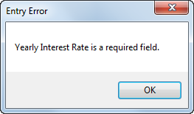
The Future Value form with a dialog box for required fields

Slide 31
The dialog box for invalid decimals

Slide 32
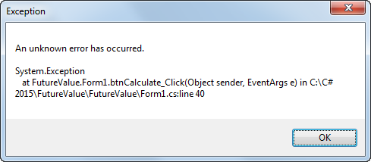
The dialog box for an unanticipated exception

Slide 33
The code for the Future Value application

Slide 34
The code for the Future Value application (cont.)

Slide 35
The code for the Future Value application (cont.)

Slide 36
The code for the Future Value application (cont.)

Slide 37
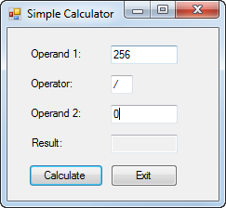
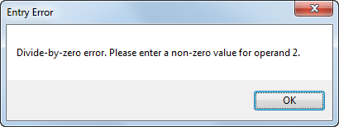
Extra 7-1 Add exception handling to the simple calculator

Slide 38
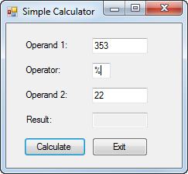
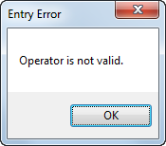
Extra 7-2 Add data validation to the simple calculator

